Slide 1
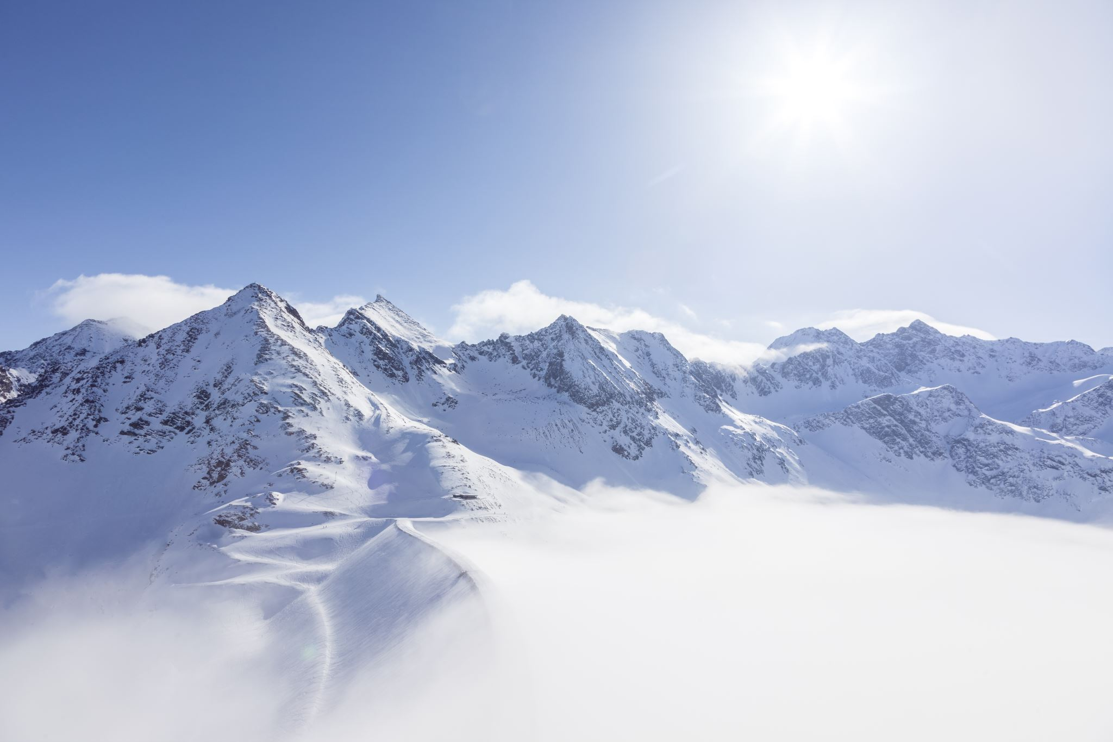
Big Mountain Resort Pricing Analysis
An investigation of Big Mountain Resort’s pricing and facility use strategies for profit maximization

Slide 2
Problem Statement
Big Mountain Resort currently sets its ticket prices based on an assumed premium above the average of other local resorts, likely failing to capture the complexities of their competitive advantages.
A model was needed that:
Provided data-driven recommendations for setting ticket prices
Gave a more granular analysis of asset usage and made recommendations for high value changes.

Slide 3
Problem Statement
Unfortunately, the data had a few limitations in the breadth of areas it covered. Specifically, we were lacking information on:
Hospitality facilities
Competitive support
Off season usage/facilities
Amenity prices (hotel rooms, food, etc.)
Operating costs (administration, food service, ski coaches/patrol, etc.)
It is unknown how many, if any, of these factors might have been significant and that limitation should be kept in mind for the rest of this analysis.

Slide 4
Recommendations and Key Findings
Bottom line: It is recommended that you increase the daily weekend ticket price by to $98, leading to an estimated $2,987,250.00 in additional revenue per season.
We also recommend you adding additional runs, additional chairlifts and extending the amount of vertical drop available could have a significant positive impact on revenue.
Finally, should you find it necessary to close lifts, we wish to recommend that you do so in groups, as the public’s desire for additional runs does not change linearly (ie: if you’re going to close one lift, you may as well close two).

Slide 5
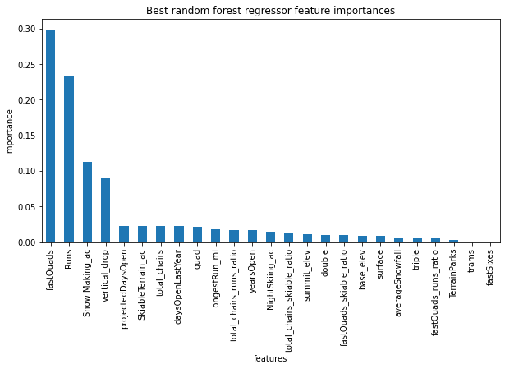
Modeling Results and Analysis
After cross validating several models, a random forest was chosen as the most accurate. It found that four variables were of standout importance in predicting ticket price:
Fast quad lifts
Total number of runs
Acres of Snow-making terrain
Feet of vertical drop
While it has a roughly median ticket price compared to other American ski resorts, Big Mountain is significantly above average in all four of these areas.
We believe the resort is severely undervalued and the market would support a $17 increase in ticket price (+/- $10).

Slide 6
Modeling Results and Analysis
Despite Big Mountain’s lead, the value of these features has not yet been maximized. Several scenarios were run and we believe several things could yet be changed to further maximize revenue.
By adding two acres of snow making area, the most high-value variable in our model, the estimated supported ticket price rises an additional $1.99 for $34,746.38 of additional revenue per season.
We also predict that adding a run, increasing the vertical drop by 150 feet, and installing an additional chair lift is estimated to support a $1.55 increase in the ticket price (total), which leads to $27,083.33 of additional revenue per season.

Slide 7
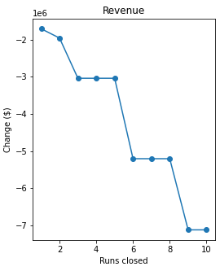
Modeling Results and Analysis
For further consideration, if the Big Mountain intends any run closures it's important to be aware that ticket price should not decrease linearly as runs are removed.
There is a considerable drop off in recommended ticket price at three, six and nine run closures. This suggests that if there's a plan to reduce the number of lifts these cutoff points be kept in mind (ie: if you plan on closing three you may as well close five, etc.)

Slide 8
Summary and Conclusion
Big Mountain is a well positioned, and above average among US ski resorts. It is currently undervaluing itself keeping in mind the limitations of our analysis could see a dramatic increase in revenue of up to $3,049,079.71 if all the prior recommendations are followed.
Increase ticket price by $17 (It should be noted that we did not test the effect of price changes over time so the effect of making such a large change at once is unknown)
Increase ticket price by $1.55 after adding a run, 150ft of vertical, and a new fast quadlift
Increase ticket price by $1.99 after adding two more acres of snow-making area
If chairlifts must be removed, do it in groups (of 2, then 3, then 3)

Slide 9
Thank you for Coming
Graham Smith, Data Scientist
Graham.macisaac09@gmail.com

